Slide 1

Update of China-ADNI
Kuncheng Li, MD. PhD.
Dept. of Radiology, Xuanwu Hospital,
Capital Medical University Beijing:100053,
Email: cjr.likuncheng@vip.163.com
WW-ADNI 2017, London, United Kingdom
Notes:
Dear Chair, colleagues, goodmorning! I am Kuncheng Li, from Beijing. on behalf of China-ADNI to report our progress.

Slide 2
Outline
General information of China-ADNI
Progress of the China-ADNI
Notes:
The report have two parts. Part one is to introduce general information of China-ADNI.

Slide 3
China-ADNI
Scientific advisory board
Administration committee
PI: Prof. Kuncheng Li, CMU
CO-PI: Prof. Jun Wang, BJU
CO-PI: Prof. Hongzheng Wang, BUMC
Clinical core
Liyan Qiao
MRI core
Kuncheng Li
PET core
Fang Li
Pathology core
Cuidi Wang
Biomarker and Genetics Core
Jun Wang/Yan Zhang
Biostatistics and Informatics core
Li Wang
DATA Post process
Core
Yong Fang
Although China-ADNI joined WW-ADNI only 4 years of history, we have made the gradual progress.
Notes:
Although officially joined WW-ADNI only 4 years of history, but we have made the gradual progress. China-ADNI have a scientist advisory board, clinical, MRI, PET, pathology, biomarker and genetic, biostatistics and informatic, and data post process core. PI is me, kuncheng Li, and Jun Wang, Hongzhen Wang are co-PI. After more than four years running, the workflow among different core became more smoothly.

Slide 4
Initial plan of China-ADNI
800-1000 subjects (80 sites)
Normal | Early MCI | Late MCI | Mild AD
200-250 | 200-250 | 200-250 | 200-250
Notes:
The initial plan of China-ADNI is to collect 800-1000 subject that includes volunteer as normal control, early and late MCI, mild AD four groups.

Slide 5
Research plan
Neuropsychological battery
Biomarkers:
Blood: Apo E polymorphism, Amyloid 40, 42, and tau
CSF: Amyloid 40,42 and tau
MRI: Multimodal
PET: ¹⁸F-FDG
¹⁸F-AV-45
Notes:
This is research plan: We have to collect the data of neuropsychological battery, APOE polymorphism, Amyloid 40,42 and tau in blood and amyloid 40,42, and tau in CSF. Imaging examination including multimodal MRI and PET, later including eighteen fluorine FDG and AV45.

Slide 6
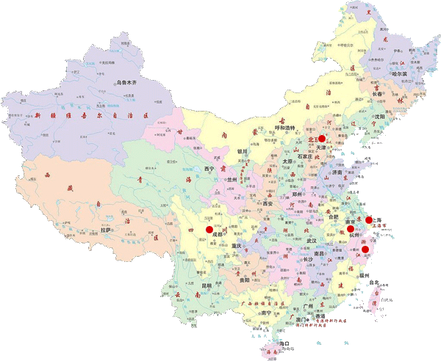
10 sites in 6 cities have joined in this study, they are distributed in the northern, eastern, central and southwestern parts of mainland China.
Notes:
there are six cities joined in the project, distributed in the northern, eastern, central and southwestern area （Beijing,Hangzhou, Nanjing, Chongqing, Nanchong and Wuhan). the number is same with last year,

Slide 7
Outline
General information of China-ADNI
Progresses of the China-ADNI
Notes:
The second parts of report is about the progress of the China-ADNI over the past year.

Slide 8
Enrolled Subjects
93 new subjects were enrolled in the past year,
Normal | Early MCI | Late MCI | Mild AD
3 | 26 | 30 | 34
Total of 214 cases
Normal | Early MCI | Late MCI | Mild AD
19 | 63 | 62 | 70
Notes:
we have collected 25 new subject in the past 12 months, so total of 146 cases in China-ADNI.

Slide 9
Neuropsychological battery
Screening: MMSE, LM-I, LM-II, GDS, CDR，Hachinski
Baseline: ADAS-Cog，CWRT，MoCA, BNT, Rey AVLT(30’ Delay), Category fluency, Trial making test A&B,NPI, FAQ
6 month: MMSE, CDR, MoCA, ADAS-Cog，E-cog,BNT, Rey AVLT(30’ Delay), Category fluency, Trial making test A&B, NPI, FAQ
12 month,24 month 36 month: MMSE, LM-I, LM-II,DR,ADAS-Cog, E-cog, Rey AVLT(30’ Delay), MoCA,Category fluency Trial making test A&B,BNT, NPI , FAQ
Notes:
This is neuropsychological battery, all kinds of scale are in strict accordance with the requirements of WW-ADNI, including screening, baseline and 6 month, 12 month, than 24 month and 36 month
follow-up re-evaluation.

Slide 10
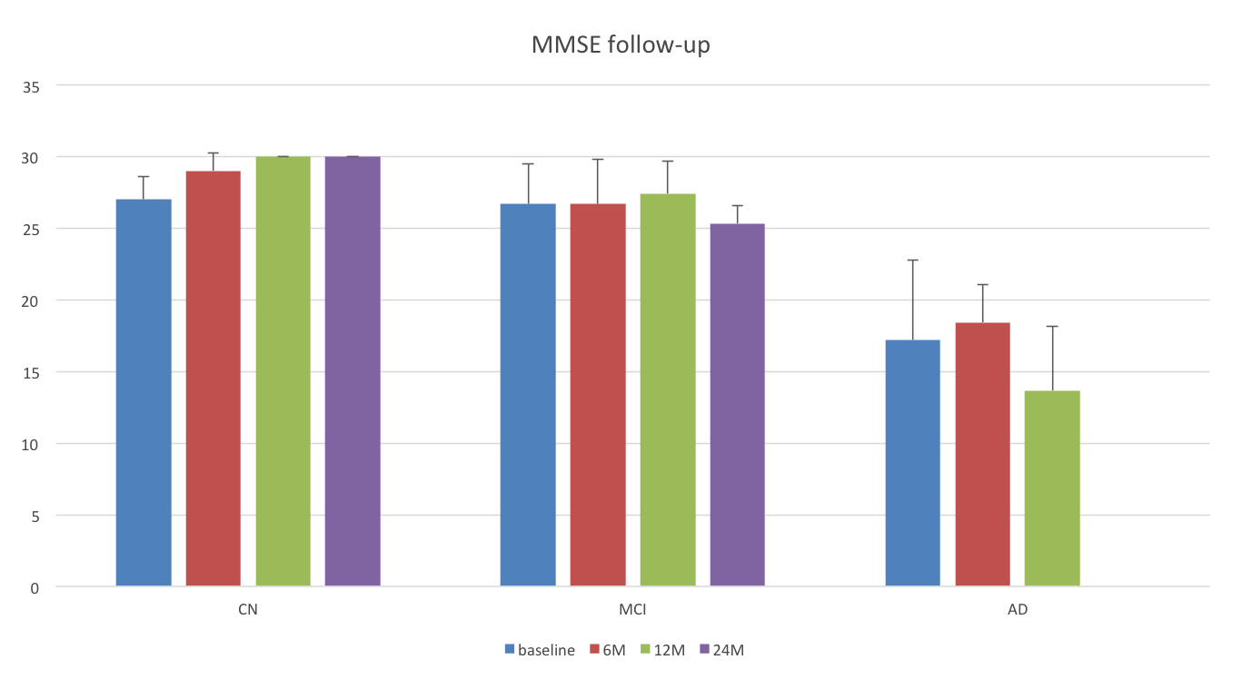
Baseline, 6, 12 and 24 months

Slide 11
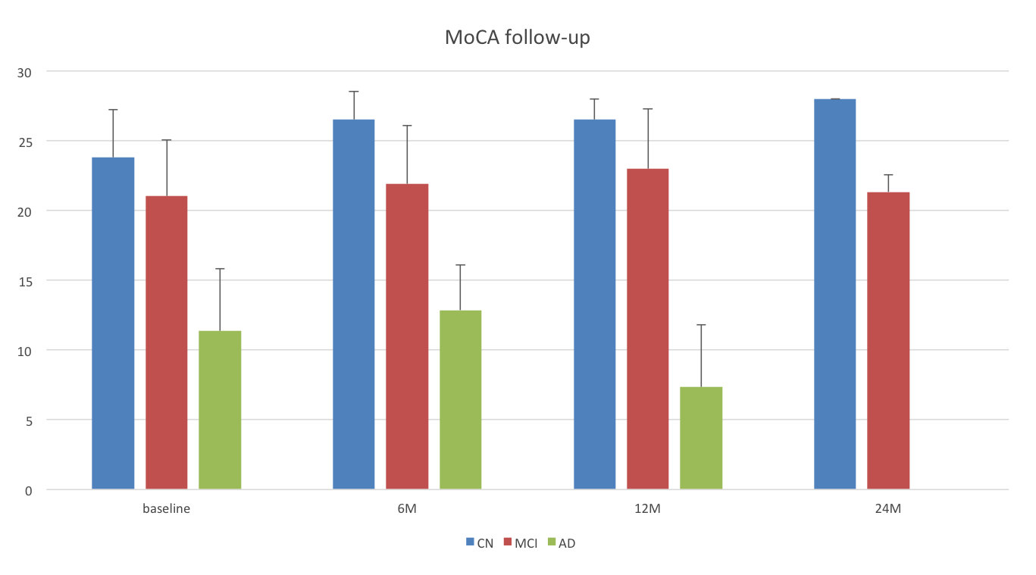
Normal, MCI and AD

Slide 12
MRI Study
Standard protocol for MRI scanning
Quality control among different sites
Improvement of the post-processing methods
Notes:
We have performed standard protocol for MRI scanning according to the WW-ADNI guideline, and implement quality control among different sites, and improve the post-processing methods.

Slide 13
Scanning protocol of MRI
3D T₁ volume
Diffusion tensor imaging
Resting state fMRI
Arterial spin labelling
Susceptibility weighted imaging
Notes:
Scanning protocol of MRI is including 3D-T1 volume, DTI, rs-fMRI, ASL perfusion and SWI of brain.

Slide 14
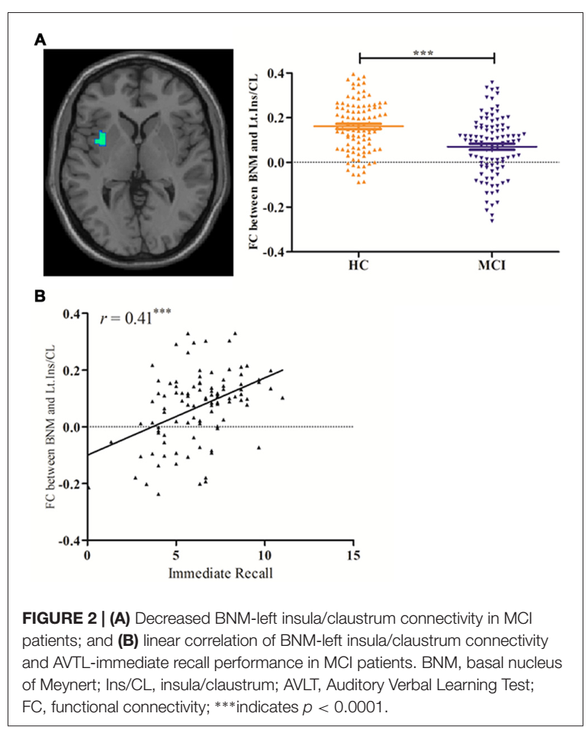
Altered Functional Connectivity Of the Basal Nucleus of Meynert in MCI
Decreased BNM-left insula/claustrum connectivity in MCI patients
linear correlation of BNM-left insula/claustrum connectivity and AVTL-immediate recall performance in MCI patients

Slide 15
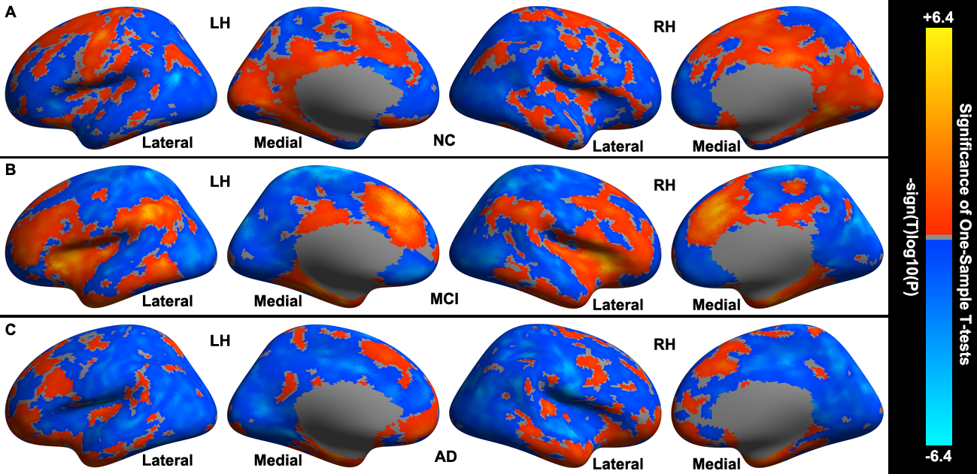
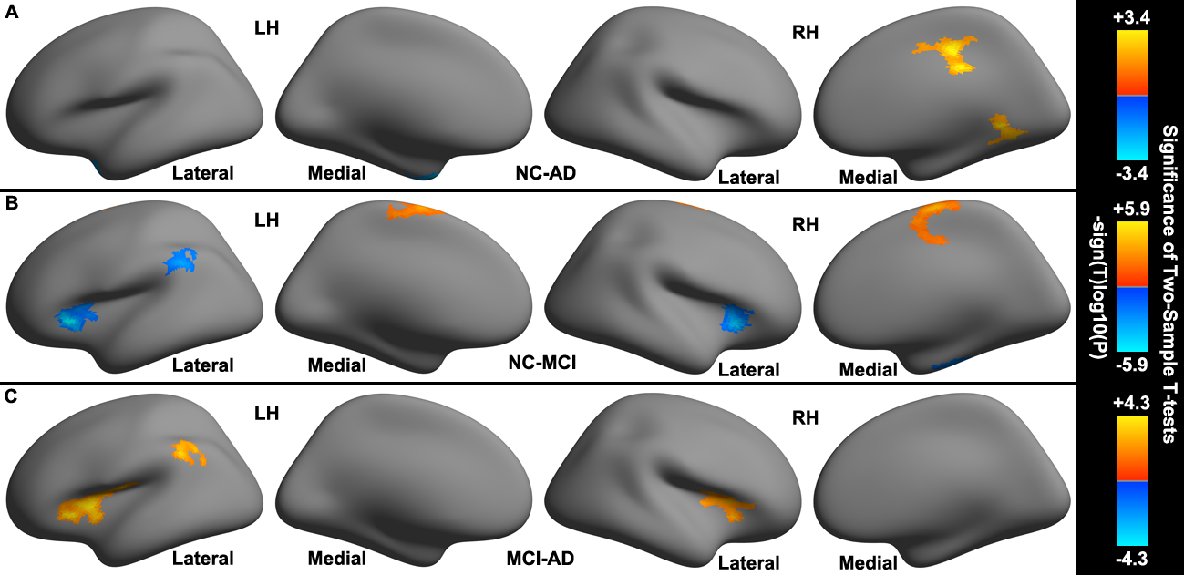
Cerebral areas showing significant changes in functional connectivity to cerebella limbic network in NC, MCI, and AD group
Significant differences of the functional connectivity to cerebella limbic network among NC, MCI, and AD groups.

Slide 16
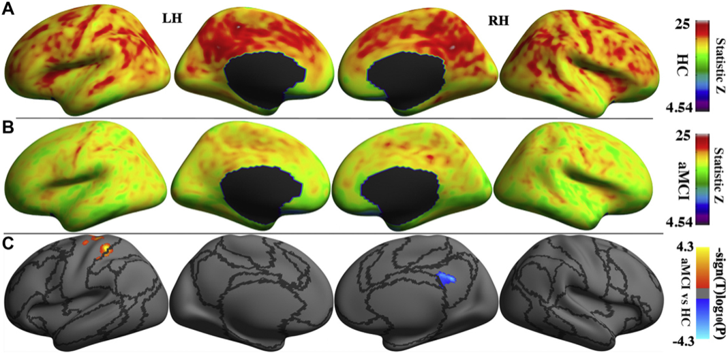
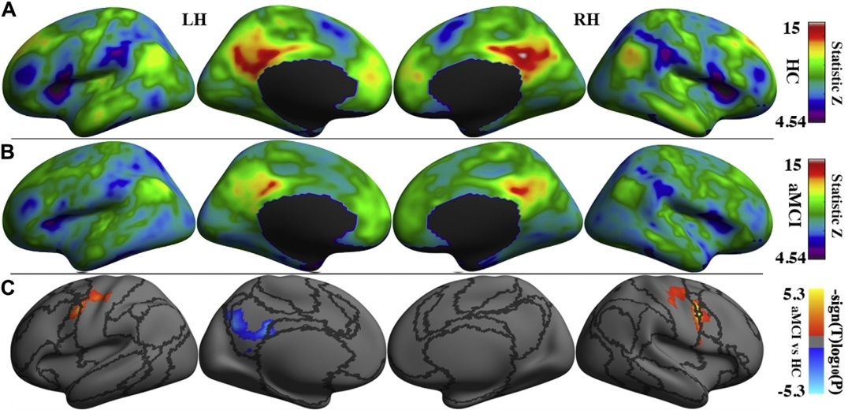
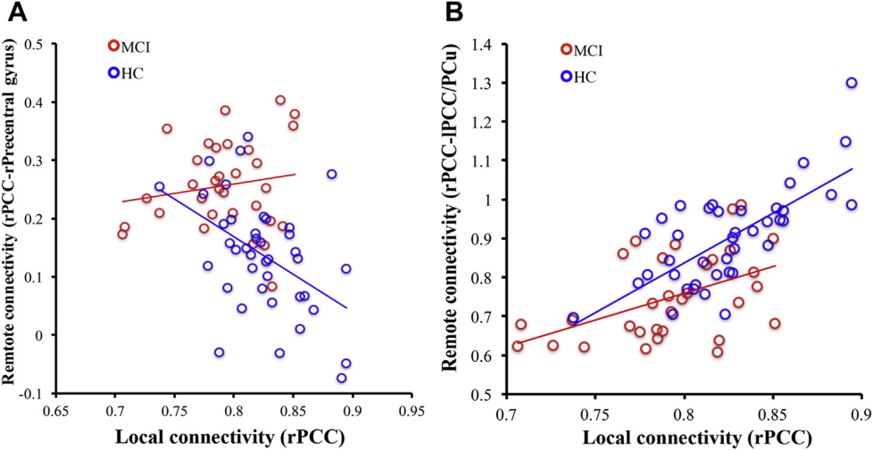
MCI alters local synchronizations in the default and somatomotor networks
Dysfunctional remote functional connectivity in aMCI patients.
Local-to-remote cortical connectivity in amnestic mild cognitive
impairment

Slide 17
Future diagnostic model
Chanel 1
Chanel N
Chanel 1
Chanel N
Quick clinical
decision
Multi-Chanel deep learning model n
Weighted Bayes network
Blood+Neuropshycometiric evaluation
Early diagnosis of MCI with deep-learning and multi-source information mixed together

Slide 18
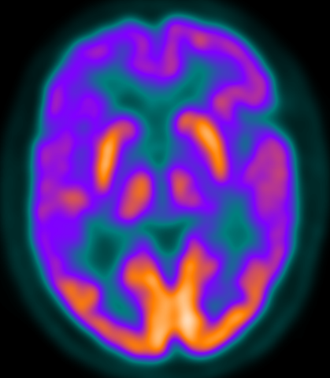
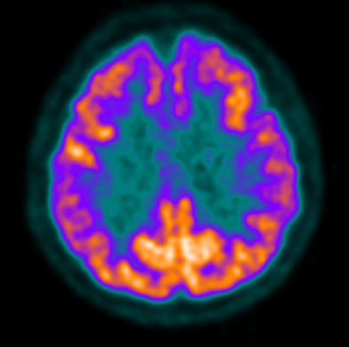
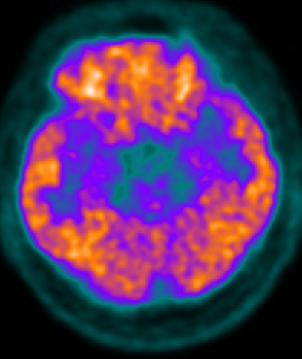
PET Study
Nearly 80% cases have undergone the baseline examination by FDG-PET, the hypometabolic region could be depicted in AD and some MCI patients.
AD
MCI
NC
Notes:
Nearly 80% cases had undergone the baseline examination of FDG-PET, hypometabolic region could be depicted in AD and some MCI patients.

Slide 19
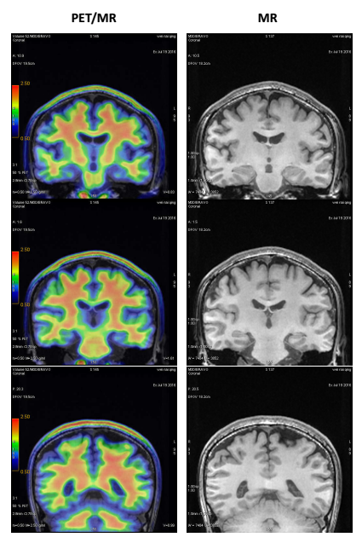
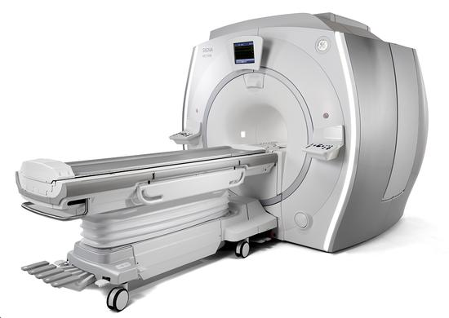
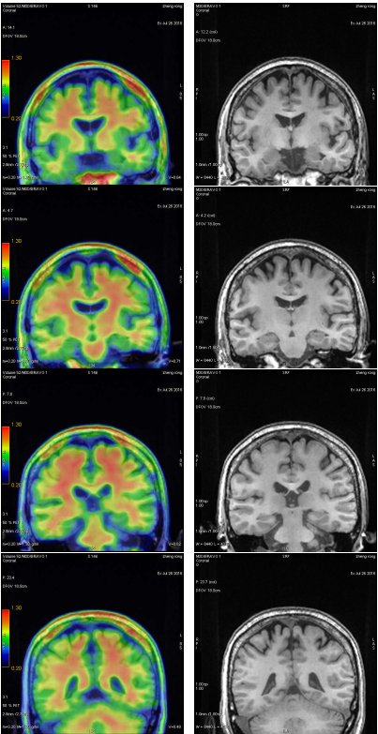
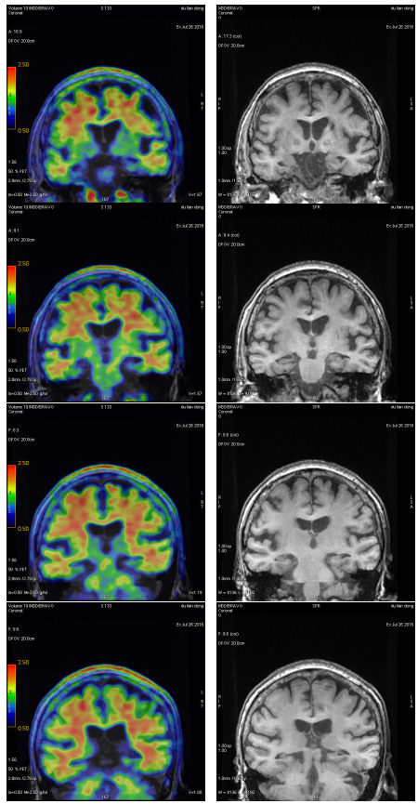
[¹⁸F]AV45--Aβ
NC, 53y, M MMSE=29
MCI, 64y, F
MMSE=22
AD, 79y, F
MMSE=13
Hybrid PET/MR has be applied in the research

Slide 20
A longitudinal clinical trial on acupuncture is in progress
MCI and AD patients enrollment
MRI scan
Neuropsychological test
Standard Acupuncture Treatment
120 MCI and AD patients were divided into true and false acupoints groups and neuropsychological test and rs-fMRI examination are in performing, and subjects will be followed-up them for total three years (This is the second year).
MRI scan
Neuropsychological test
Purpose: To evaluate the effect of acupuncture for MCI and AD.
Notes:
we have began to carry out a longitudinal clinical trial. We are going to enroll 120 MCI and AD patients which was divided into true and false acupoints groups and neuropsychological test and rs-fMRI examination were finished, follow-up them three years.The aim is to evaluation the effect of acupuncture for MCI and AD.

Slide 21
Acknowledgements
all the colleague of China-ADNI
the support from WW-ADNI
Notes:
Finally, I express my gratitude to all the colleague of China-ADNI, and many thanks to the support from WW-ADNI. So far we could catch pace up with WW-ADNI, and we can do more in future.

